Slide 1


Validation of Combined Vector Field Approach With Full Quadrotor Dynamics
Presented By
Supervisor
Dheeraj
Dr. Sikha Hota

Slide 2
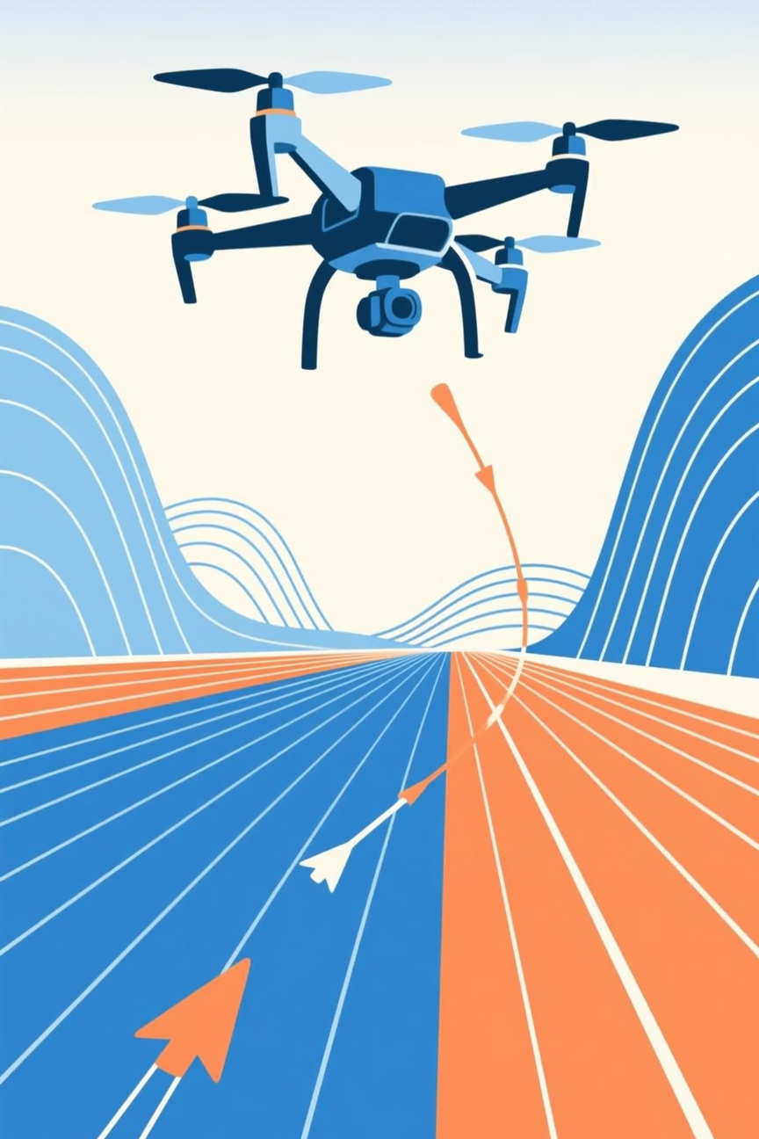



Introduction
UAVs are integral to modern Aerospace applications, ranging from surveillance and reconnaissance to delivery, environmental monitoring, and precision agriculture.
Autonomous operations require precise path following to a desired path. To achieve this, a robust path-following algorithm is necessary.
There are mainly two types of path-following algorithms:
Virtual Target Point (VTP) based
includes Carrot-Chasing Algorithm, Non-Linear Guidance Law (NLGL), Pure Pursuit, and Line of Sight (PLOS) based Guidance Law, etc.
Vector Field (VF) Based
includes Lyapunov Guidance Vector Field (LGVF), Combined Vector Field (CVF), etc.

Slide 3
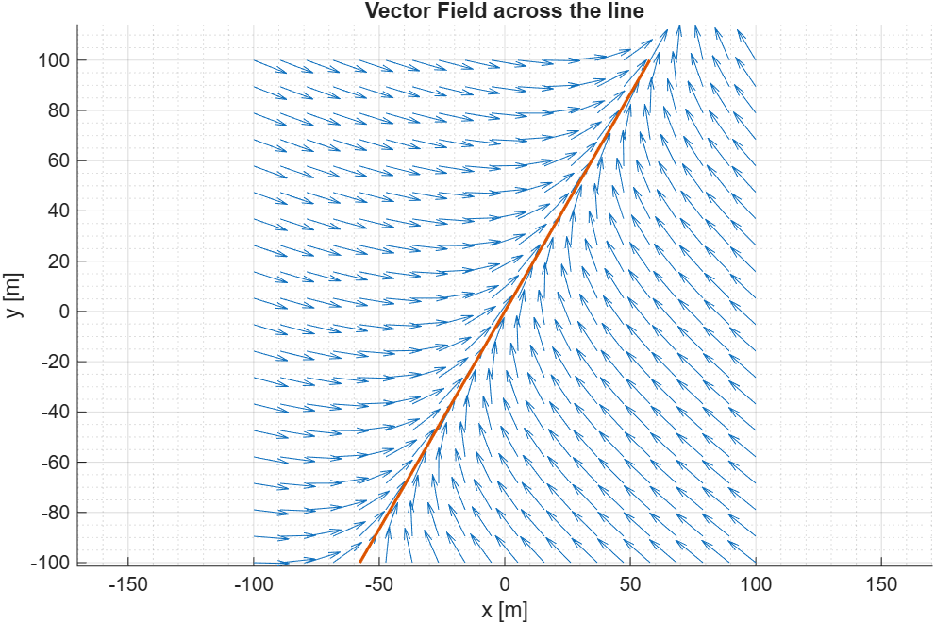

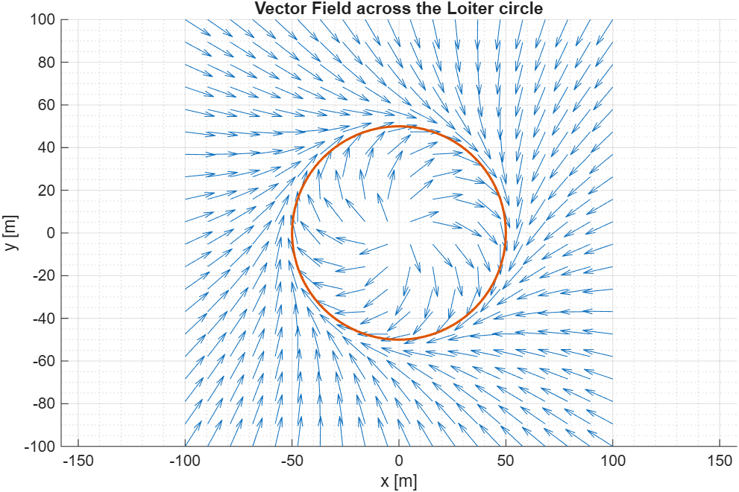

Introduction
This paper discusses the Combined Vector Field (CVF) approach and its validation, which is also a belongs to the class of Vector Field based guidance.
Why Vector Field?
Reduced Oscillations
Exhibits reduced cross-track oscillations compared to Way Point methods.
External Disturbances and Wind Handling
Can gracefully handle the environmental disturbances and wind disturbances. Which is way more difficult to do in way point/VTP based methods

Slide 4


Problem Statement
2D Case
UAV has an attitude hold with zero climb rate and velocity hold for constant airspeed (Va)
The kinematic model of the UAV can be given as
Given 2D arbitrary twice differentiable curved path C2: f(x, y) = 0, we define the directional distance between the current UAV position (p = (x, y)), to curve C2 as
This implies that if |r| is large, the UAV is very far away from the curve C2, and if r = 0, the UAV has converged to the desired curve.

Slide 5
Problem Statement
2D Case
The 2D path following problem can be summarized as:
To design the input command u1 for the UAV whose kinematics are given as in the previous slide, such that:
i) The input constraints holds.
ii) and if possible, force the UAV to fly along C2, and if not, force it to make the absolute directional distance |r| as small as possible.
Then, to validate the derived 2D path following algorithm with the full quadrotor dynamics.

Slide 6
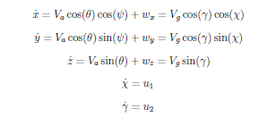
Problem Statement
3D Case
Similar to the 2D case, UAV has a velocity hold for constant airspeed (Va)
The kinematic model of the UAV can be given as
Given 3D arbitrary twice differentiable curved path C3: { f(x, y, z) = 0 & g(x, y, z) = 0 }, we define the directional distance between the current UAV position (p = (x, y, z)), to curve C2 as
Similar to 2D Case, if |r| is large, the UAV is very far away from the curve C2, and if r = 0, the UAV has converged to the desired curve.

Slide 7
Problem Statement
3D Case
The 3D path following problem can be summarized as:
To design the input commands u1 and u2 for the UAV whose kinematics are given as in the previous slide, such that:
i) The input constraints and holds.
ii) and if possible, force the UAV to fly along C3, and if not, force it to make the absolute directional distance |r| as small as possible.
Then, to validate the derived 3D path following algorithm with the full quadrotor dynamics.

Slide 8
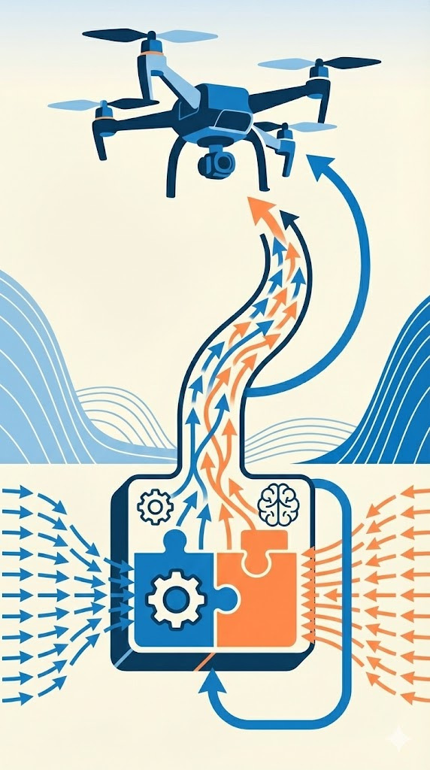
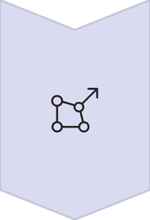

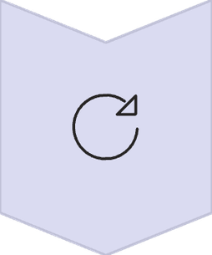
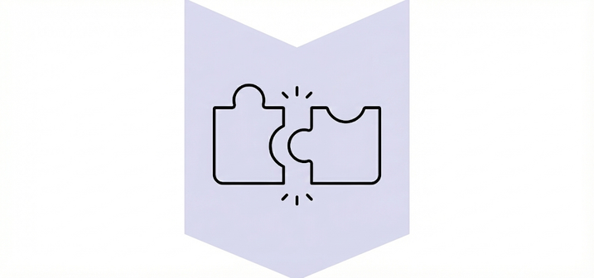
Combined Vector Field (CVF) Based Guidance
The CVF approach uses Helmholtz decomposition of Vector Fields to get conservative and solenoidal components for path following.
Helmholtz Decomposition
Any vector field can be split into a conservative (irrotational) and a solenoidal (rotational) part.
Conservative Component
Forces the UAV towards or away from the desired path.
Solenoidal Component
Aligns the UAV with the direction of the curves in the path.
Re-Combination
Recombines both the conservative and solenoidal vector fields with the appropriate weighting factors to formulate the Combined Vector Field.

Slide 9



Combined Vector Field Formulation
2D Case
To follow the twice differentiable 2D curve path given by f(x, y) = 0,
Conservative part of the vector Field
Solenoidal part of the vector Field
Then, the Combined Vector Field can be given as

Slide 10
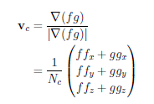
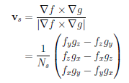

Combined Vector Field Formulation
3D Case
To follow the twice differentiable 3D curve path given by f(x, y, z) = 0, g(x, y, z) = 0
Conservative part of the vector Field
Solenoidal part of the vector Field
Then, the Combined Vector Field can be given as

Slide 11




Controller Design
A Saturated PD course controller and saturated PD course and climb controller are formalized respectively for the 2D and 3D, to follow the path described by the derived Combined Vector Field.
2D Case

Slide 12
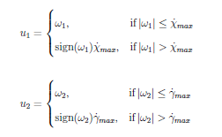

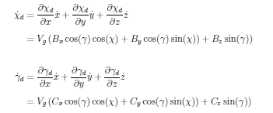
Controller Design
3D Case

Slide 13
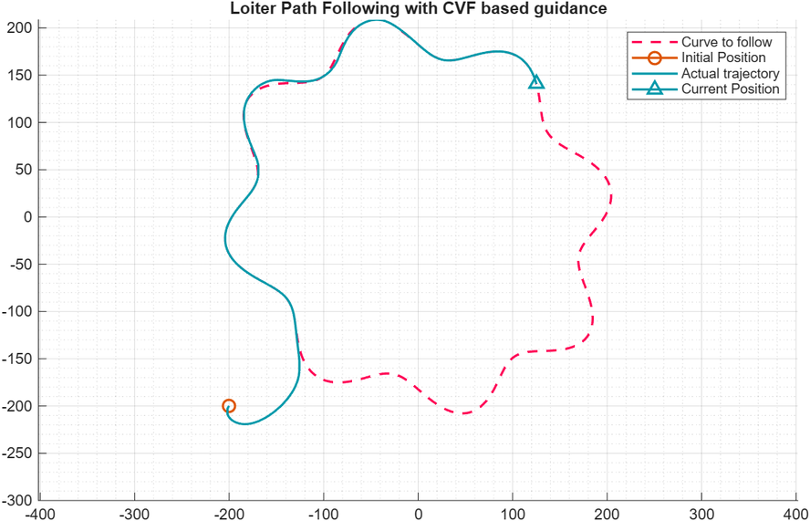
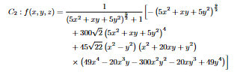
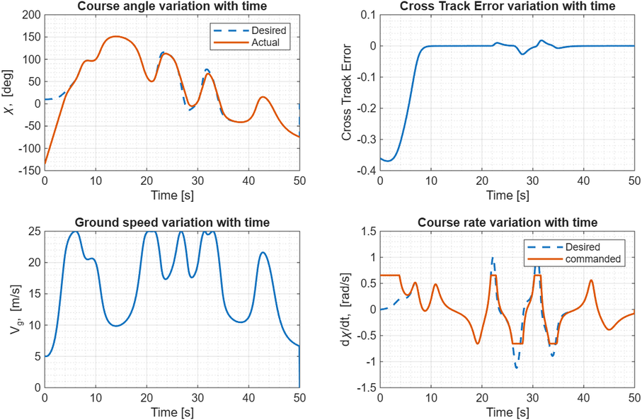
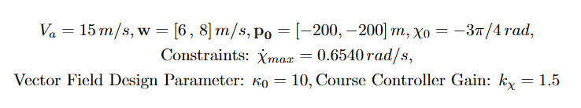
Simulations
2D Path Following with CVF
Star Curve

Slide 14
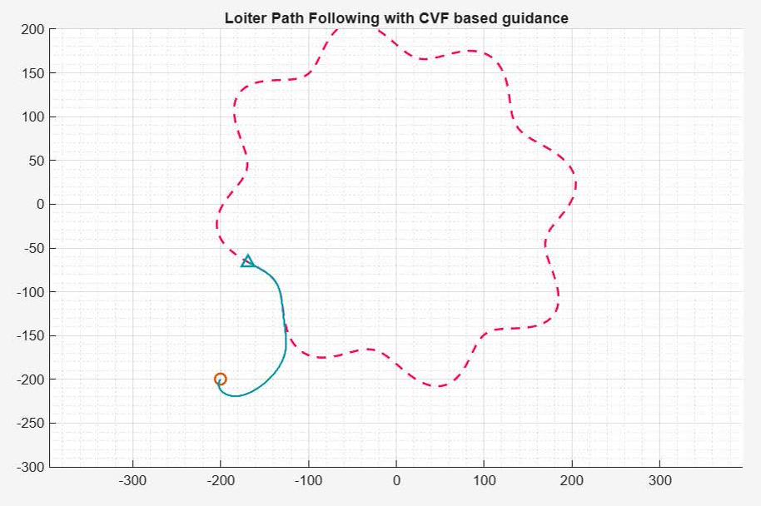
Simulations
2D Path Following with CVF
Star Curve

Slide 15
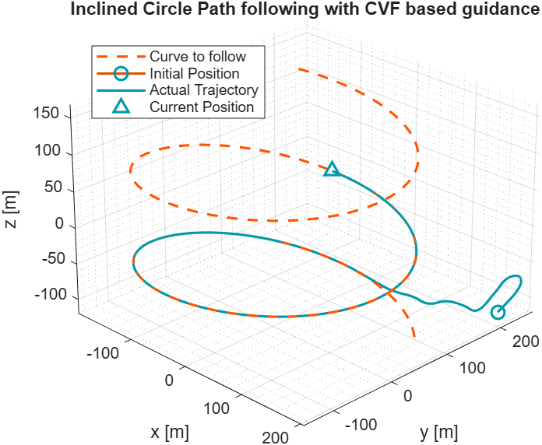

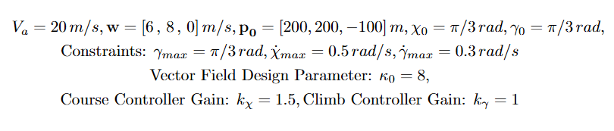
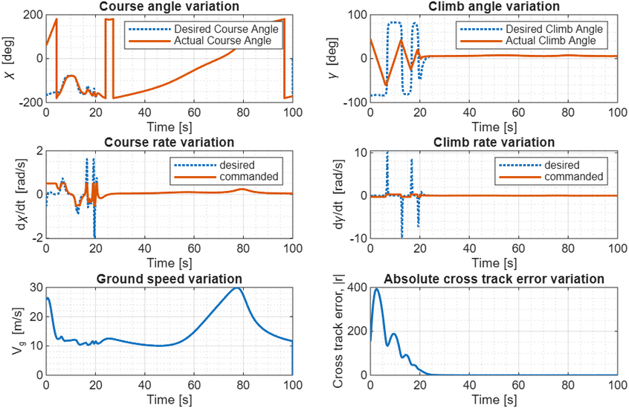
Simulations
3D Path Following with CVF
Helix Curve

Slide 16
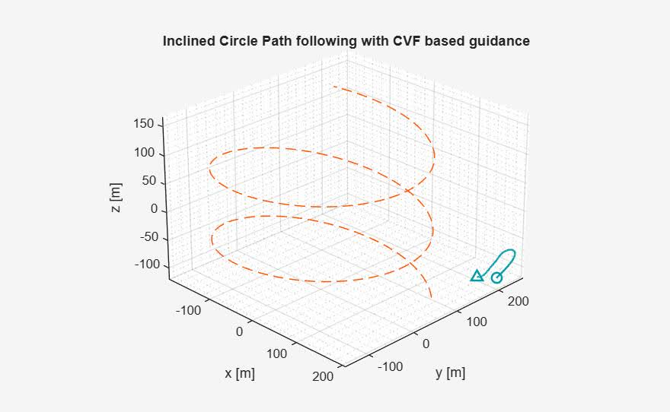
Simulations
3D Path Following with CVF
Helix Curve

Slide 17
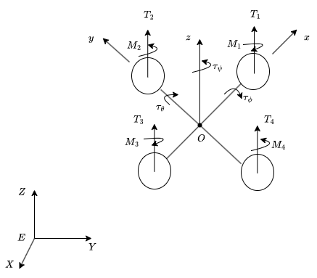
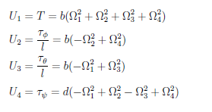

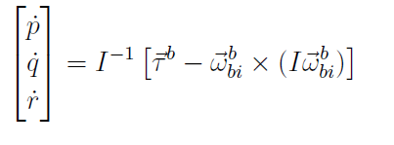
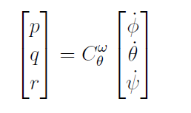
Validation of CVF Approach with Quadrotor Dynamics
Validation of CVF-based path following incorporates full quadrotor dynamics and Sliding Mode Controllers (SMC).
Quadrotor Dynamics
Model forces and moments on the quadrotor, considering propeller thrust and drag.
Full Quadrotor dynamics is used to estimating the states of the UAV, and
A simplified version of the dynamics model is used to design the controller.
Full Non-Linear Quadrotor Dynamics
and

Slide 18
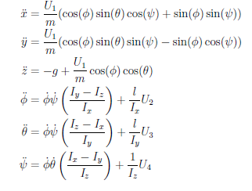
Validation of CVF Approach with Quadrotor Dynamics
Simplified Dynamics

Slide 19


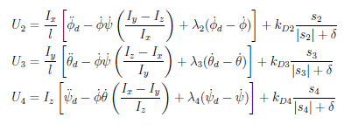
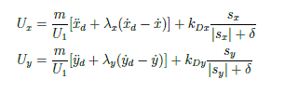
Validation of CVF Approach with Quadrotor Dynamics
Quadrotor Control
Six Sliding Mode Controllers used for each degree of freedom
PD Sliding Surface
Sliding Mode Control (SMC)
Composed of continuous (Equivalent control) and discontinuous (Switching function) parts.
Control Laws
The switching function(discontinuous control) drives the UAV towards the sliding surface, and the equivalent control(continuous control) drives the UAV on the sliding surface towards the equilibrium.
and a parameter δ is included to reduce the chattering around the sliding surface.

Slide 20
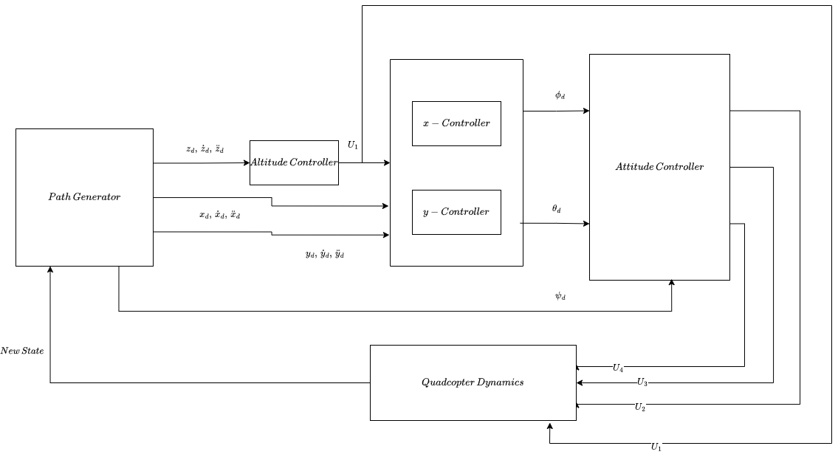
Validation of CVF Approach with Quadrotor Dynamics
Autonomous Guidance and Control Architecture of the Full Quadrotor

Slide 21

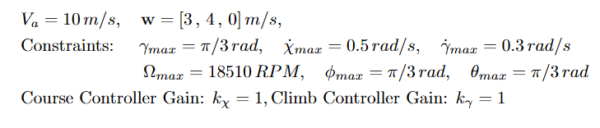
Simulations
Q250 Quadrotor is chosen for the Simulations
The gain values for the particular Quadcopter taken as
k_D: is the gain, which drives the UAV from arbitrary location to the Sliding Surface
λ: is the gain, which drives the UAV from the Sliding Surface to the Eqlbm point
δ: boundary layer thickness, used to reduce chattering

Slide 22
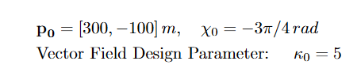

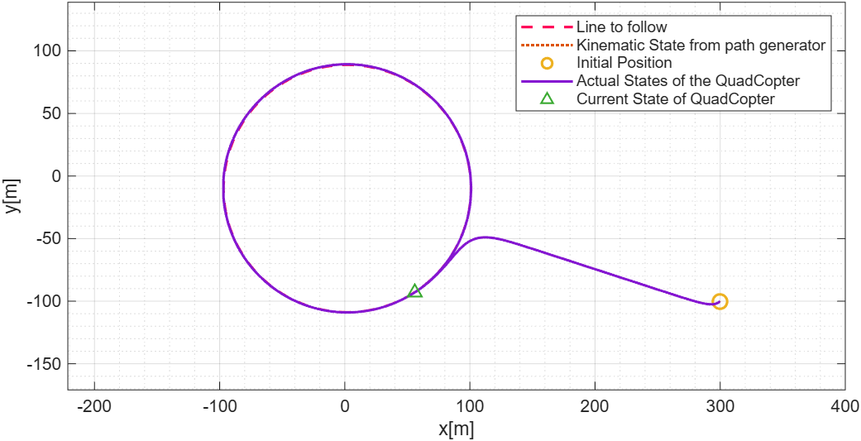
Simulations
2D Loiter Path Following

Slide 23
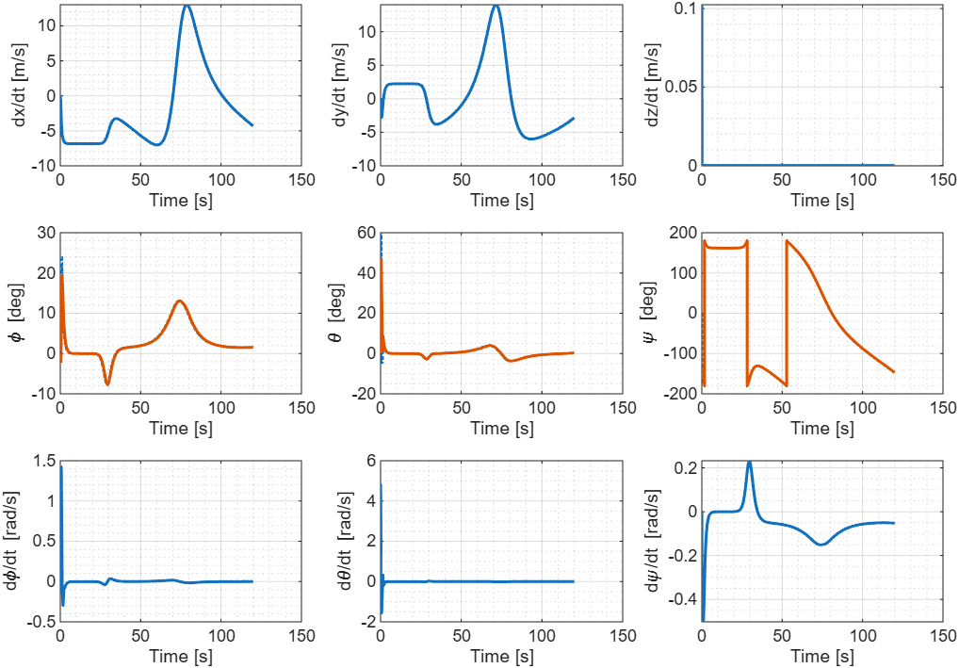
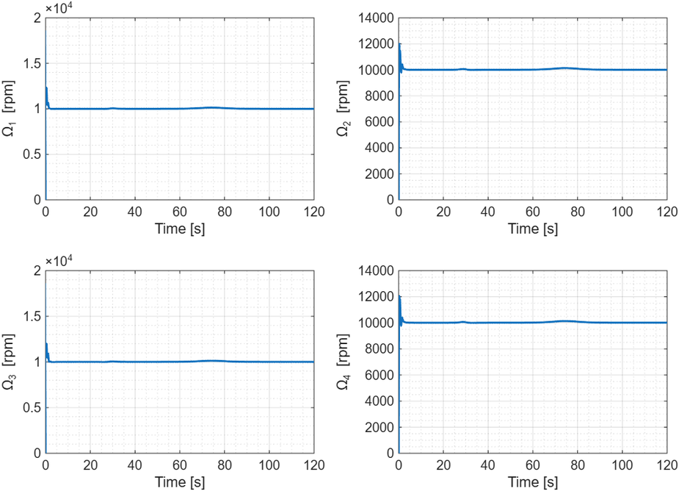
Simulations
2D Loiter Path Following

Slide 24

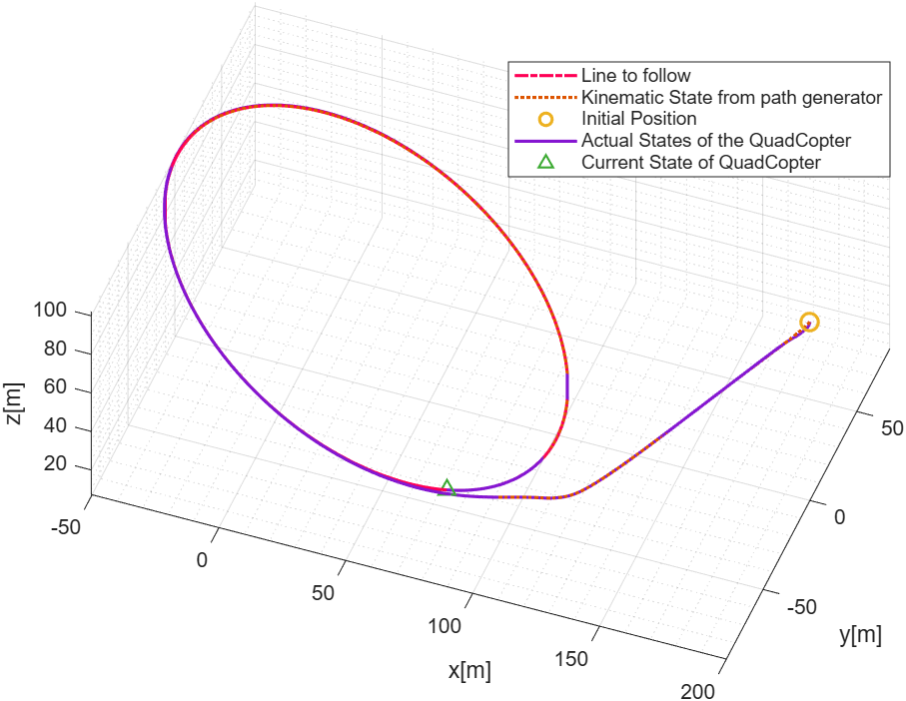
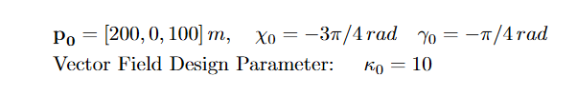
Simulations
3D Inclined Circle Path Following

Slide 25
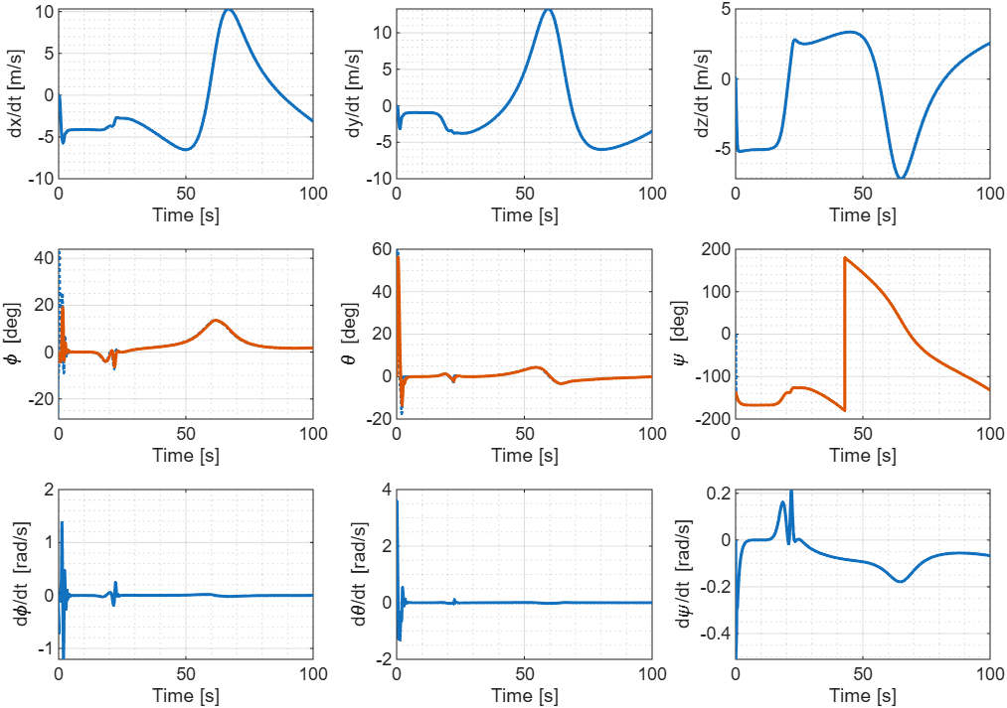
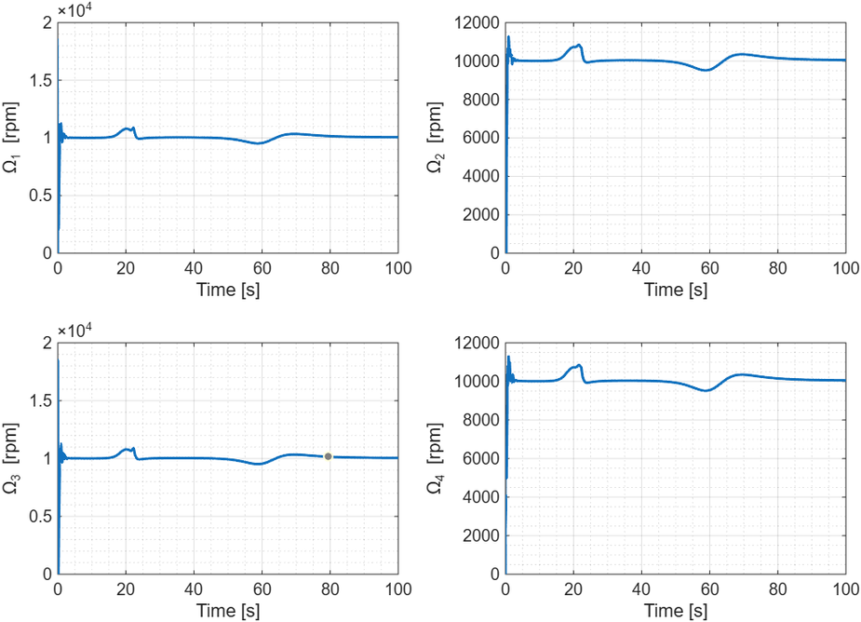
Simulations
3D Inclined Circle Path Following

Slide 26
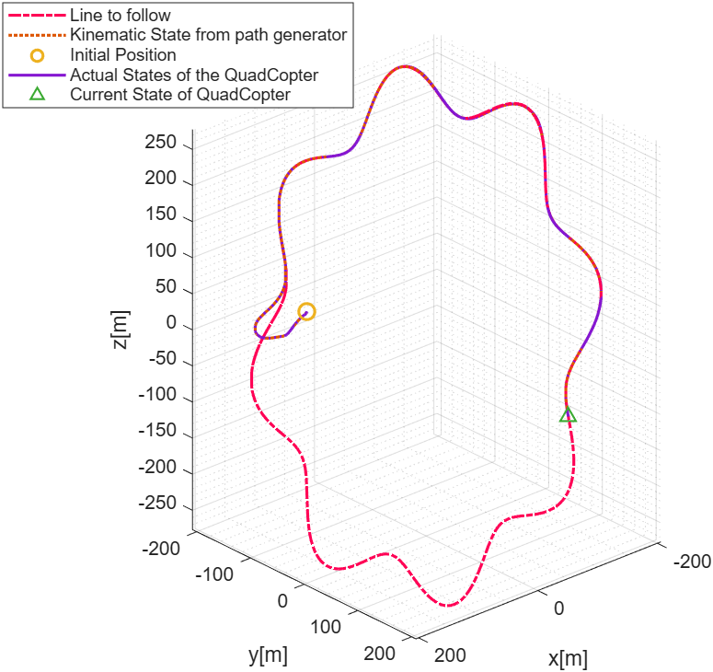



Simulations
3D Inclined Star Curve Path Following

Slide 27
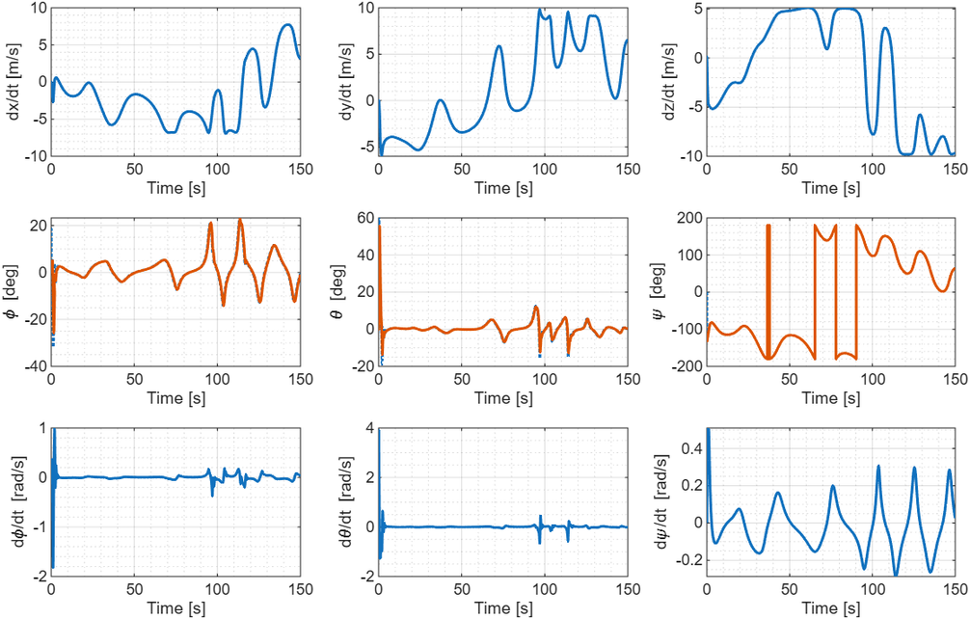
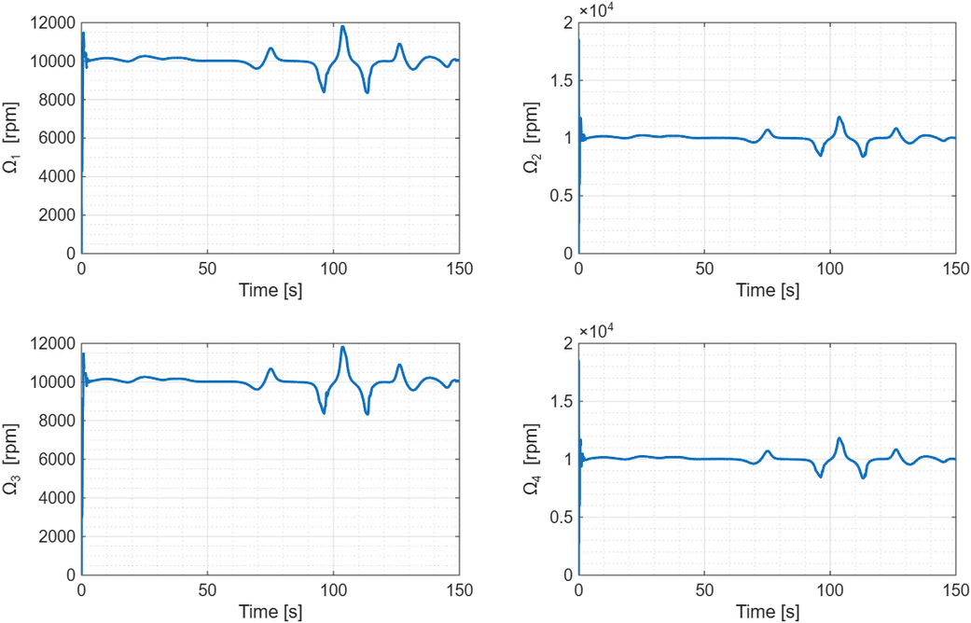
Simulations
3D Inclined Star Curve Path Following

Slide 28
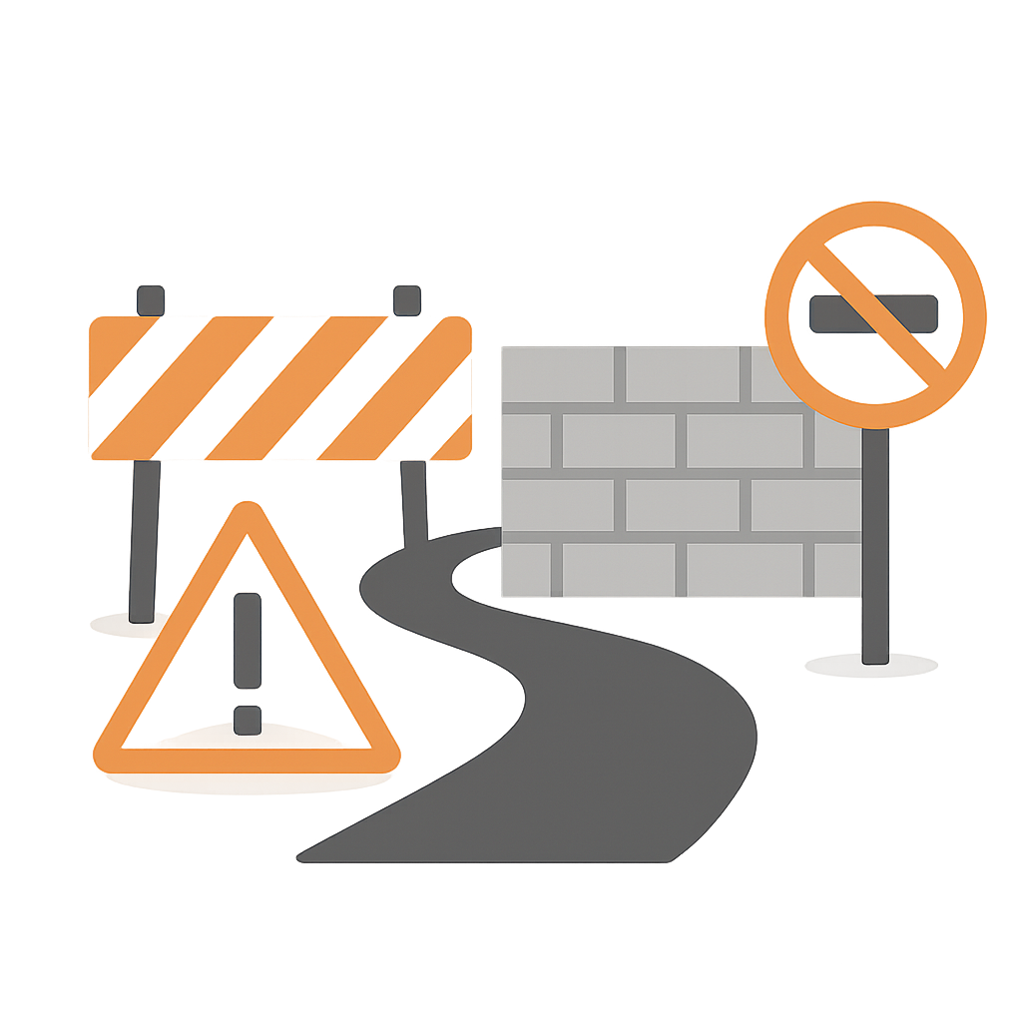
Limitations of the Combined Vector Field Approach
  Requires twice differentiable paths
  No common design parameter κ exist for all curve.
  High sensitivity for the design parameter κ.
  Very dependent on the scaling of the desired path function. (f = 0 and λf = 0 does not result same behaviour)
  It cannot be easily extended to the trajectory tracking problem.
  Extension to 3D increases the computational cost.
  proper proof of the stability and convergence of the UAV to the desired path does not exist

Slide 29

Future Work
  To Validate the Combined Vector Field (CVF) approach with experiments.
  To extend the Combined Vector Field (CVF) approach to obstacle avoidance
  Fixed time convergence to the path

Slide 30
References
[1] P. Sujit, S. Saripalli, and J. B. Sousa, “Unmanned aerial vehicle path following: A survey and analysis of algorithms for fixed-wing unmanned aerial vehicles,” IEEE Control Systems Magazine, vol. 34, pp. 42–59, February 2014.
[2] Y. Liang and Y. Jia, “Combined vector field approach for 2d and 3d arbitrary twice differentiable curved path following with constrained uavs,” Journal of Intelligent & Robotic Systems, vol. 83, no. 1-3, pp. 331–360, 2016.
[3] D. R. Nelson, D. B. Barber, T. W. McLain, and R. W. Beard, “Vector field path following for small unmanned aerial vehicles,” in Proceedings of the American Control Conference, (Minneapolis, MN, USA), pp. 5788–5794, June 2006.
[4] D. R. Nelson, D. B. Barber, T. W. McLain, and R. W. Beard, “Vector field pathfollowing for miniature air vehicles,” IEEE Transactions on Robotics, vol. 23, pp. 519–529, June 2007.
[5] V. I. Utkin, “Variable structure systems with sliding modes,” IEEE Transactions on Automatic Control, vol. 22, no. 2, pp. 212–222, 1977.
[6] C. Edwards and S. K. Spurgeon, Sliding Mode Control: Theory and Applications. Taylor & Francis, 1998.
[7] M. Herrera, W. O. Chamorro, A. P. G´omez, and O. Camacho, “Sliding mode control: An approach to control a quadrotor,” in 2015 Asia-Pacific Conference on Computer Aided System Engineering (APCASE), pp. 314–319, 2015.
[8] R. Elagib and A. Karaarslan, “Sliding mode control-based modeling and simulation of a quadcopter,” Journal of Engineering Research and Reports, vol. 24, no. 3, pp. 32–41, 2023.

Slide 31
Thank You

